Slide 1
Global Economic and Demographic Trends Analysis
Presented by ALBIN K A
DA DS DECEMEBR BATCH 2024
23/07/2025

Slide 2
Project Overview
The objective of this project is to analyze and derive insights from global data covering population, GDP, country characteristics, and health-related indicators from multiple sources.
USED TOOLS - SSMS,EXCEL,POWER B I

Slide 3
agenda
Data Cleaning & Transformation
Statistical Analysis
DAX Calculations
Data Visualization –[ DASHBOARD ]
INSIGHTS

Slide 4
Data Cleaning & Transformation
DATA SOURCES :
SQL Database (CountriesWorld file)
Excel Files (PopulationPerCountry, MetaData, GDP by Country 1960-2016 files)
Created a database named 'CountriesWorld' and established a connection with Power BI
Used Excel to perform basic cleaning tasks, including removing empty columns and filling or deleting cells with null values.
After importing all three Excel files containing GDP data by country into Power BI, I used Power Query Editor to select all year columns and unpivoted them into a single 'Year' column.
Appended three GDP tables and combined all three datasets into a single consolidated table using Power BI's 'Append Queries' feature.
Standardized data types and established relationships across all tables using the 'Country' column as the common key.

Slide 5
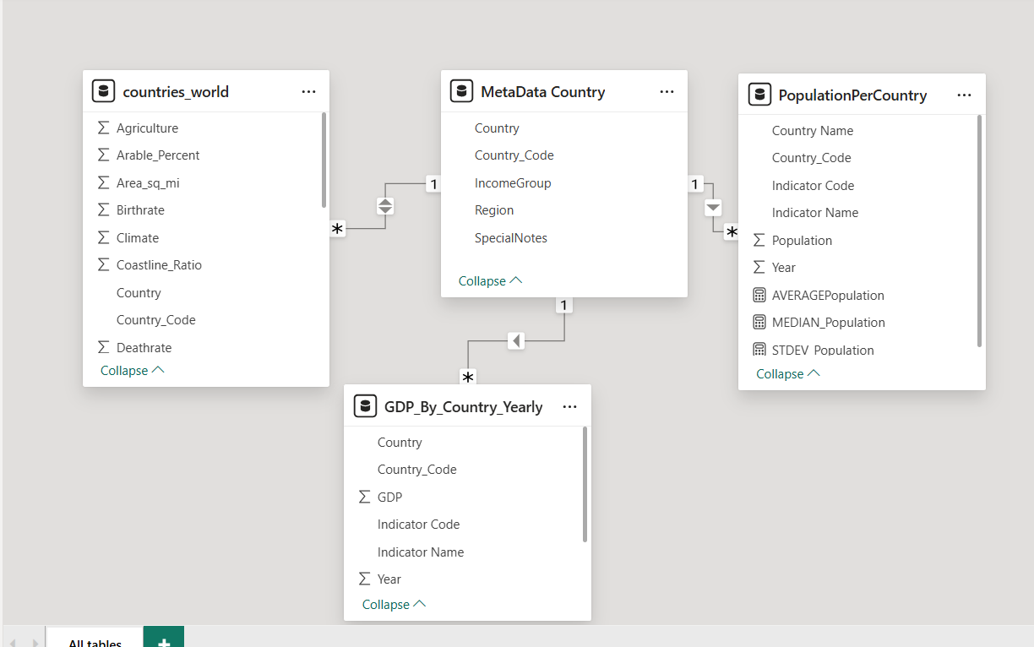
established relationships across all tables

Slide 6
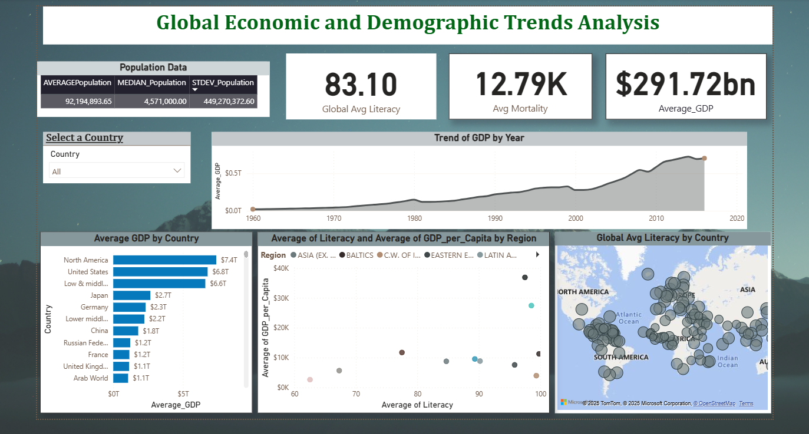
DASHBOARD

Slide 7
Statistical Analysis & DAX
POPULATION DATA
CARD DATA
AVERAGEPopulation = AVERAGE('PopulationPerCountry'[Population])
MEDIAN_Population = MEDIAN('PopulationPerCountry'[Population])
STDEV_Population = STDEV.P(PopulationPerCountry[Population])
Average_GDP = AVERAGE(GDP_By_Country_Yearly[GDP])
Avg Mortality = AVERAGE('countries_world'[Infant_Mortality])
Global Avg Literacy =
AVERAGE('countries_world'[Literacy])

Slide 8
INSIGHTS
GDP Growth Is Consistently Upward Over TimeThe GDP trend from 1960 to 2016 shows a strong upward curve.
It Indicates global economic expansion despite challenges across decades.
The scatter plot suggests regions with higher literacy tend to have higher GDP per capita.
Global Literacy Is Relatively Strong—but Uneven.
The standard deviation of population (≈ 449M) is strikingly large compared to the mean and median.

Slide 9
“You cannot control your own population by force, but it can be distracted by consumption”
– Noam Chomsky

